Slide 1
27/04/2020
Rapid Assessment of Contaminant Exposure (RACE) tool
Webinar
Ana Luisa Afonso
Paolo Angelo Colombo
Tilemachos Goumperis
Luca Pasinato
Ruth Roldán Torres

Slide 2









RACE tool
IT tool
Exposure
Tox
Notes:
Good morning everyone and welcome to the EFSA webinar on the RACE tool. Rapid assessment contaminant exposure tool

Slide 3
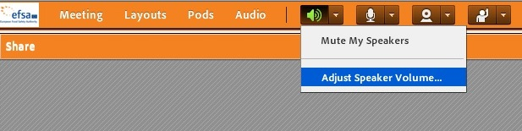
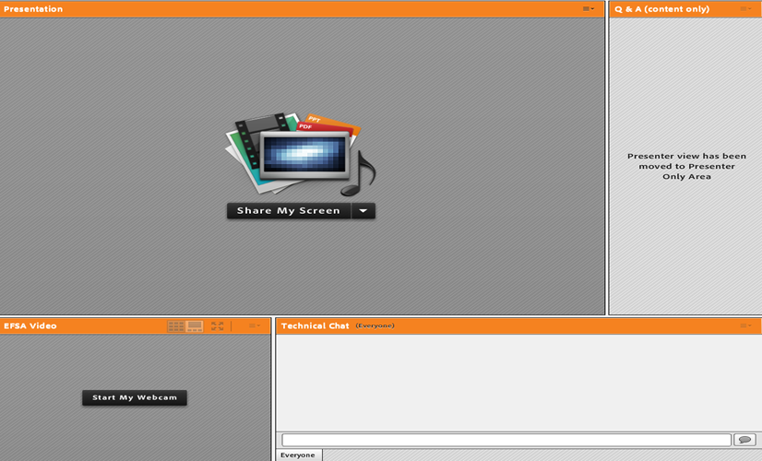

Webinar guide for attendees
This webinar is being recorded!
The webinar is in English and questions should be submitted in English through the platform (see hereunder).
You are automatically connected to the audio broadcast. One-way audio (listen only mode).
Presentation
window
Q&A box: For any questions related to the topic
Notes:
I am Ana, senior scientific officer at EFSA and one of my tasks is to support with scientific and technical advice the Rapid Alert System for Food and Feed. I would like to introduce my colleagues Tilemachus, Paolo , Ruth and Luca.
Please remember that this webinar is being recorded and hence it will be published into the webinar’s main page just after the presentation.
The layout of the Webinar is as follows : In the left bottom you will see us after the presentation, on the right hand of the screen you will find the Q&A box for the content scientific questions and in the right bottom the place for technical questions.
Luca
Good morning I am Luca and I am the RACE tool developer. I will explain how this webinar works
You can take advantage of this webinar either by following us during the next hour or so or afterwards since the webinar will be available online on the Youtube EFSA channel.
We are using Adobe connect as the platform to broadcast the webinar. The webinar will be conducted in English.
There is a Q&A section on the right of your screen and you can send us questions during the webinar. Please send the questions in English.
If you have any technical problem, let us know by writing a message in the Technical chat also on the screen.
Finally you will see the presentation with the live tool on your screen.
At the end of the webinar, we will have a questions & answers session and we will try to directly answer to some of your questions.

Slide 4
Please do not log in during the webinar
Rapid Assessment of Contaminant Exposure (RACE)
The RACE tool provides estimates of different population groups’ acute and chronic exposure to chemical contaminants from single foods and compares the result to the health-based guidance value or other relevant toxicological reference points. See the full description with user manual (Appendix J). To register: servicedesk@efsa.europa.eu

Slide 5
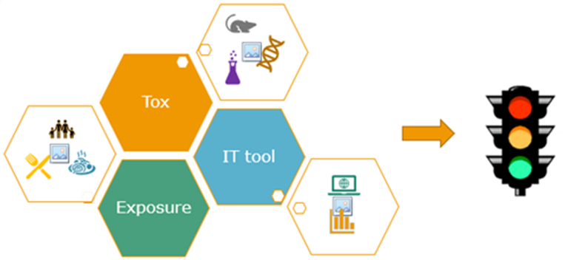
Overview of the RACE tool and purpose of its development
Methodology
  Decision trees
  Data
  Tools
Examples

Slide 6

Notes:
The tool was developed to answer to the needs of the rapid alert System for food and feed

Slide 7
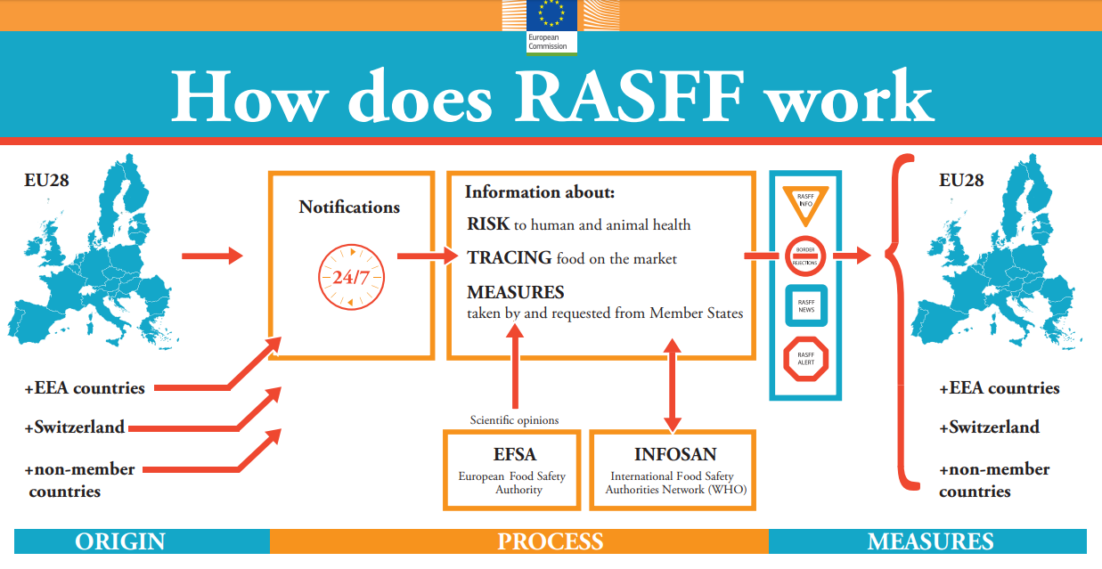
Notes:
The RASFF is an information system that allows EU MS, EEA countries Switzerland and even non member countries to exchange information about risks to human and animal health linked to food and feed
When a contaminant or any hazard is detected in food or feed the competent authorities need to assess if a potential risk exists and when these risks affect more than one country information is shared through RASFF
The assessment needs to be based on science and a decision needs to be made fast and in a transparent manner
The European Commission asked EFSA to :
Propose methodology for a risk-based classification of RASFF notifications on contaminants
Based on science but practical to use
Develop a tool to harmonise risk evaluation

Slide 8
Chemical contaminants
Group | Decision tree
1. Food contaminants | Decision tree 1
2. Food contact materials
3. Pharmacologically active substances | Decision tree 2
Notes:
The methodology developed is adequate for evaluation of contamination by food contact materials , pharmacologically active substances and other food contaminants but we will focus only on food contaminants that can include mycotoxins, heavy metals, etc.

Slide 9
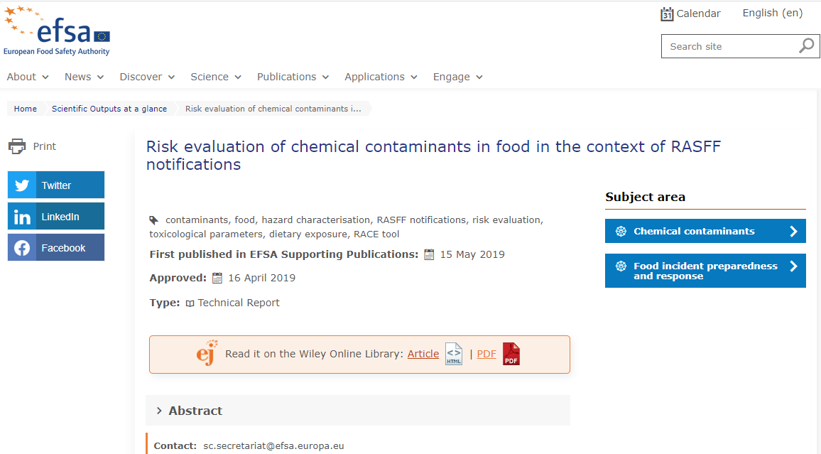
https://efsa.onlinelibrary.wiley.com/doi/epdf/10.2903/sp.efsa.2019.EN-1625
Notes:
Of course we will not be able to discuss in detail all the methodology, so please read the EFSA report….it is very nice and only 41 pages…without appendices

Slide 10




Methodology - Hazard characterization
Is the compound Genotoxic and Carcinogenic?
Is there an ARfD available?
Is there a Chronic HBGV available?
Is there a Reference Point available
Notes:
I am trying now to illustrate how we have approached the tool from a methodological point of view.
The idea, as already mentioned by the colleagues, was to develop a tool to harmonize risk evaluation for contaminated foods that has to be
Based on science
Practical
Referring to chemical contaminants
Assessing risks for human health
Considering Both acute and chronic risk
Providing Reference sources for toxicological parameters and exposure data
Resulting in an outcome…possibly clear!
A relevant aspect of the assessment of unwanted substances in foods is referring to the toxicological characteristics of the substance itself. With this aim some aspects need to be clarified starting from basic characteristics such as genotoxic and carcinogenic properties until derivation of HBGV or identification of RP. RP being a value generally identified in a (repeated) tox study devoid of adverse effects (e.g. NOAEL). HBGV results from a reference point divided by an UF (uncertainty factor or safety factor) this is possible when the RP is reliable and coming from an adequate toxicological study/ies. A typical HBGV is TDI or TWI. The first step to be considered is the possible effect on human health after one or few intakes. An acute reference dose is the HBGV indicative of such an effect as this are generally derived from intakes within 24 hours. RP after repeated exposure are often considered especially in case of possible chronic intake or substances characterized by chronic toxicities. In absence or shortage of data different approaches can be considered such as the TTC. The selected value is then compared with the possible intake to obtain the outcome that is estimating the potential risk.

Slide 11
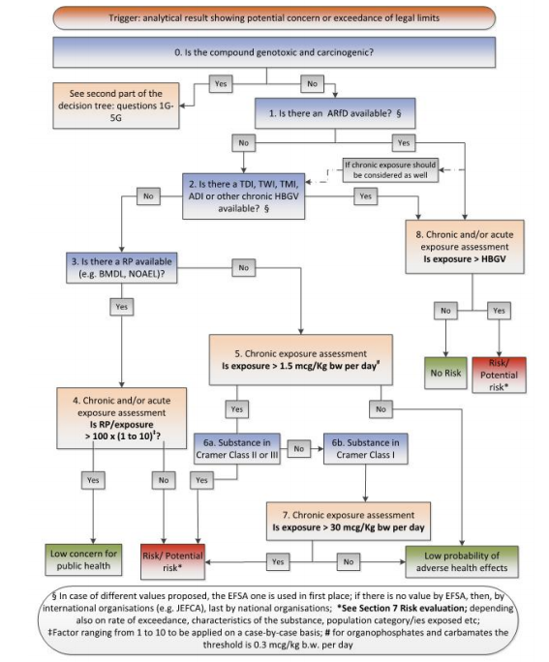

Methodology – The decision tree(s)
Not genotoxic/ carcinogenic substances
Notes:
This approach is summarized in a decision tree that you have here at a glance. This is proposed for a non genotoxic and/or carcinogenic substance. Please note that these decision trees are the ones reported and explained in the already mentioned technical report referring to “The risk evaluation of chemical contaminants in food in the context of RASFF notification” available in the EFSA web

Slide 12

Non-genotoxic/carcinogenic substances 1/2
Trigger: analytical result showing potential concern or exceedance of legal limits
2. Is there a TDI, TWI, TMI or other chronic HBGV available?
See following slide; questions 3-7
No
Yes
0. Is the compound genotoxic and carcinogenic?
If chronic exposure should be considered as well
No
Risk / Potential risk*
1. Is there an ARfD available?
Yes
Yes
No
See following slide; questions 1G-3G
8. Exposure assessment
Is exposure > HBGV
No Risk
Yes
No
*depending also on rate of exceedance, food, population category/ies exposed etc.
Note: draft decision tree for food contaminants and food contact materials
Notes:
Don’t be afraid by these apparently complicated slides! In order to be able to categorise the different substances we have created a few decision trees to define the path to be followed. It is crucial to know the key characteristics of the substance under evaluation and for that it is needed to rely on different data base. This information is not included in the tool, however the tool contains links to access adequate and reliable repository of information (that are constantly updated). Let’s see the logic behind the proposed flow: to start the first crucial q is: are we dealing with a substance that shows genotoxic and carcinogenic properties? This aspect is key to understand if a threshold can be identified or not, being genotox/carcinogenic substances by definition without a threshold. In this slide we are dealing with a non genotox/carcino molecule and the first q is then the availability of a dose indicative of an acute risk – this HBGV called ARfD: not all substances showed acute effects and only a limited number has an ARfD identified. If not available the next step would be to look for an indicator for chronic effects, in this case generally TDI and TWI: these values should be then compared with the estimated intake further to consumption of the given food. If the exposure results to be lower than the HBGV no risk can be reasonably expected, while in case of exceedance a risk cannot be excluded.

Slide 13

Non-genotoxic/carcinogenic substances 2/2
2. Is there a TDI, TWI, TMI or other chronic HBGV available?
3. Is there a RP available (e.g. BMDL, NOAEL)?
5. Exposure assessment
Is exposure >
1.5 mcg/Kg bw per day#
No
No
Yes
Yes
No
4. Exposure assessment
Is RP / exposure
> 100 x (1 to 10)‡
T T C
6a. Substance in Cramer Class II or III
No
6b. Substance in Cramer Class I
Yes
No
Yes
7. Exposure assessment
Is exposure >
30 mcg/Kg bw per day
Low concern for public health
Risk / Potential risk*
Low probability of adverse health effects
Yes
No
*depending also on rate of exceedance, food, population category/ies exposed etc. ‡margin to be defined;
# for organophosphates and carbamates the threshold is 0.3 mcg/kg b.w. per day
Notes:
When a HBGV is not available we have to accept some more uncertainty and we will be looking for a RP (this means that the available tox data are incomplete or not sufficiently robust to allow the derivation of a HBGV). A typical RP can be the NOAEL or the BMDL. (lower bound of benchmark dose confidence interval). Then the same approach then before applies: exceedance or not of the value of reference in comparison with the estimated intake. If not even a RP is available we have to deal with the little that is known about the substance, therefore accepting lower accuracy. The categorization suggested by the TTC approach (with the different Cramer classes) can be then considered to qualify the possible toxicity. It’s a sort of last chance and we won’t elaborate about it

Slide 14

Genotoxic/carcinogenic substances
3G. Exposure assessment
Is exposure > 0.0025
mcg/Kg bw per day
Low probability of adverse health effects
No
0. Is the compound genotoxic and carcinogenic?
Yes
No
Risk / Potential risk*
1G. Is there a RP (e.g. BMDL) available?
No
Yes
No
See previous slides; questions 1-8
2G. Exposure assessment
Is BMDL₁₀ / exposure
> 10,000? **
Low concern for public health
Yes
Yes
*depending also on rate of exceedance, food, population category/ies exposed etc.
**In the absence of BMDL, if T25 is available then a margin of 25,000 shall be considered.
Note: draft decision tree for food contaminants and food contact materials
Notes:
Quickly back to genotox/carcinogenic substances when a threshold in principle should not be identifiable, the assessment is based on the identification of a RP and in assessing the ratio or margin of exposure that exists between this value and the estimated intake. In the slide, based on a RP that is a BMDL10, a margin of 10000 is generally considered adequate to exclude a concern for the public health. Please remember that the MOE is only suggestive of a level of concern and does not quantify the risk. In the absence of a RP the same concept of TTC mentioned earlier on would apply. We may elaborate more and debate on these proposed approaches and on different possibilities, and also on intrinsic weaknesses and limitations, however it is not the goal of today. The one that is suggested and presented is the standard approach we have developed: we believe it is scientifically sound and able to cope with the large majority of situations. There may be other ones that can be considered of course.

Slide 15

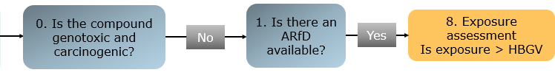

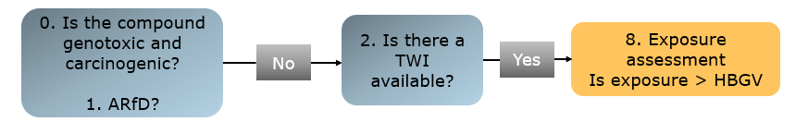

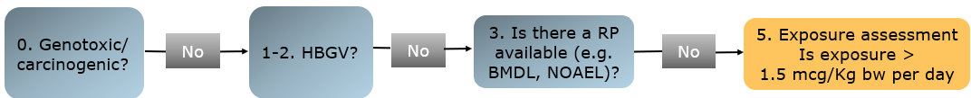
Decision tree examples
Trigger
Trigger
Notes:
On the basis of the illustrated decision trees, here a few paths that may result depending on the characteristics and data available for a given substance. This is just to give an idea about the different scenario and direction to be followed to proceed with the exercise. To quickly wrap up the first Q is about genotoxic and carcinogenicity properties, then the availability of a HBGV that can be either an ARfD or a TDI/TWI or even both, if available. The comparison with the estimated exposure is always the last step, although with different interpretations: it can be estimated an excess to what is considered a safe intake, or the assessment of the existing margins of safety or to verify to be within certain limits. And about the possible outcomes…these will be presented in a few minutes. I am now handling over to Tilemachos to explore the next steps

Slide 16






Hazards and Food
Hazard characterisation
Reference values established by EFSA can be retrieved from the EFSA chemical hazards database OpenFoodTox
(http://www.efsa.europa.eu/en/data/chemical-hazards-data)
Food description
According to EFSA FoodEx2 food categorisation catalogue
Exposure assessment
RACE uses data from EU comprehensive food consumption database
Notes:
The Comprehensive Food Consumption Database is a source of information on food consumption across the European Union. It contains detailed data for a number of EU countries
OpenFoodTox - open source data for:
substance characterisation
links to EFSA’s related output
background European legislation
and a summary of the critical toxicological endpoints and reference values

Slide 17
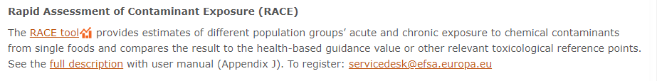
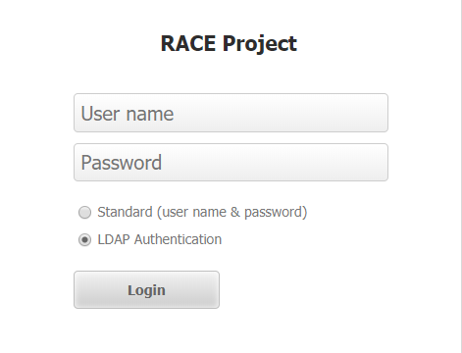
Tool
link https://www.efsa.europa.eu/en/microstrategy/race.
Notes:
To access the RACE tool you need to have an account, to get it: just write an email to servicedesk@efsa.europa.eu, our colleagues will guide you through the activation.
Once your account is ready, you can access the RACE tool through the link https://www.efsa.europa.eu/en/microstrategy/race.
You will be prompted with the request of a username and a password, please beware to keep the LDAP option selected.
During the first access you will be requested to accept EFSA terms of use.

Slide 18
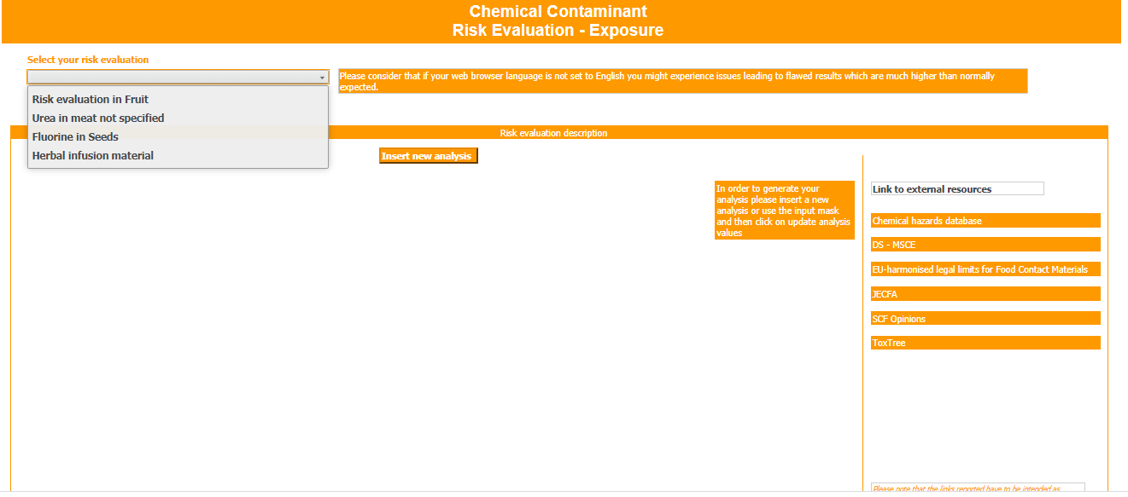
Tool
Click here to retrieve an analysis you already inserted
Click here to insert a new analysis
Notes:
LUCA
During the first access you will be requested to accept EFSA terms of use.
To insert the first analysis click on insert analysis.
To retrieve it click on select your analysis.

Slide 19
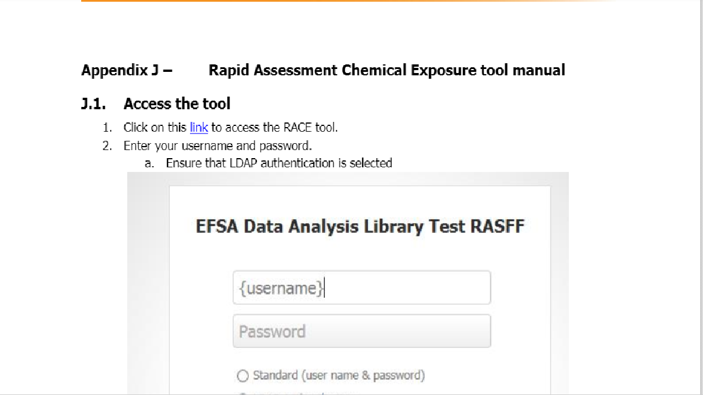
Tool
https://www.efsa.europa.eu/en/science/tools-and-resources
Notes:
To have a full overview of how the tool works please refer to the appendix J of the technical report.
There you will find a step by step description of all relevant passages
Please refer to the webpage https://www.efsa.europa.eu/en/science/tools-and-resources
For all relevant links to the tool and the manual

Slide 20
RACE tool 27 April 2020
Q&A

Slide 21
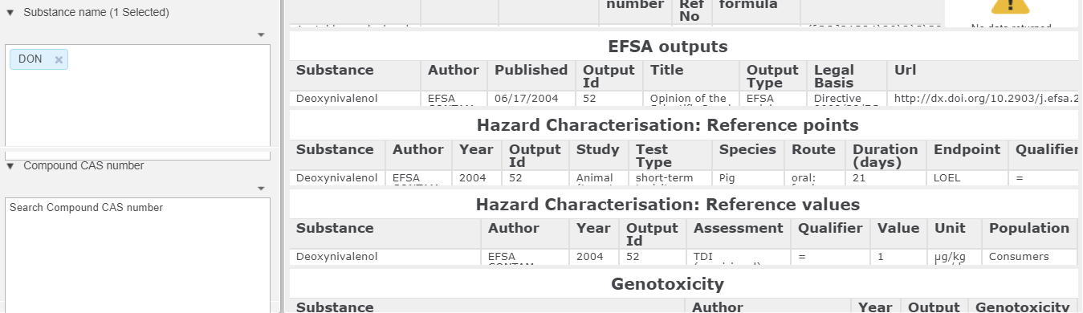
DON example
APPLY
Notes:
To be used if there is a problem with accessing OpenFoodTox

Slide 22
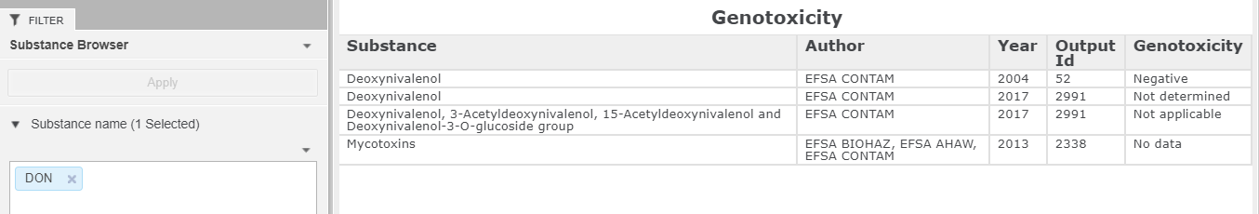
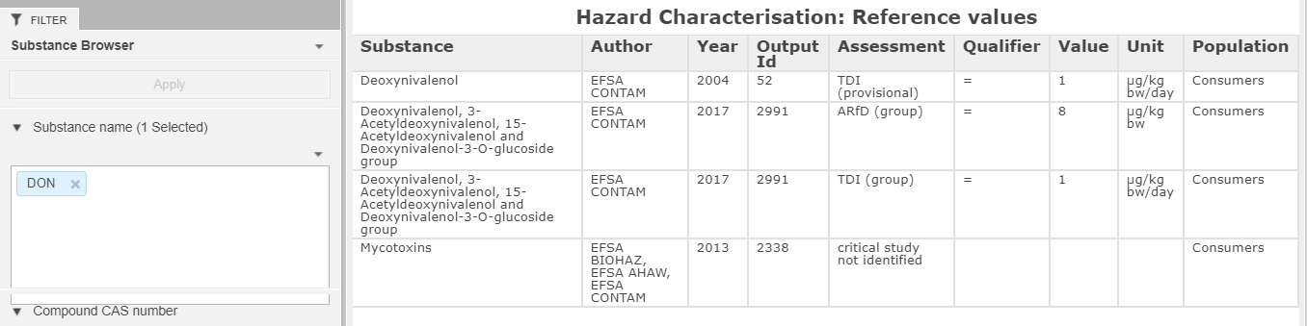
DON example cont’d
Notes:
To be used if there is a problem with accessing OpenFoodTox

Slide 23
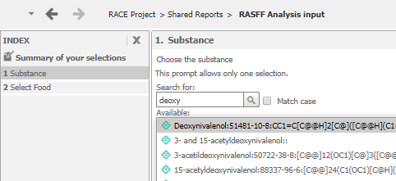
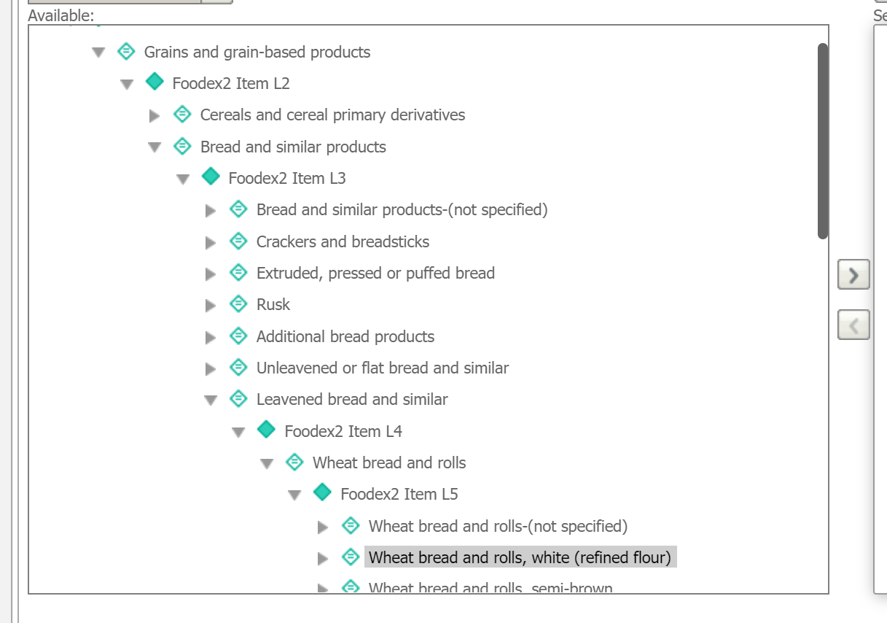

Slide 24
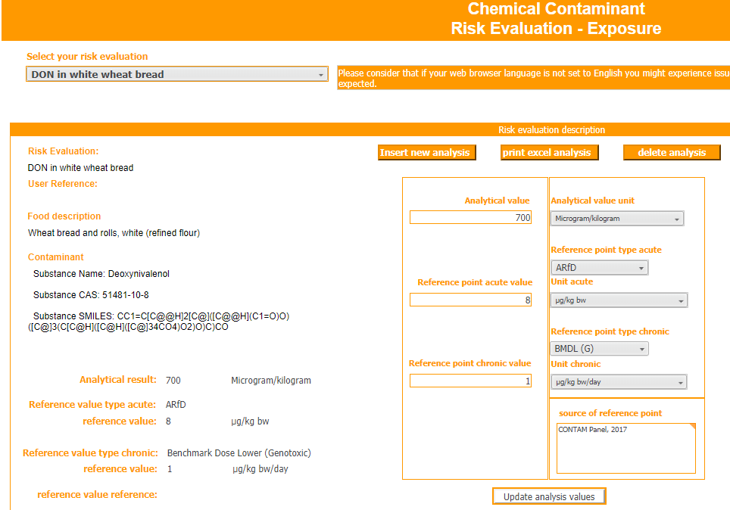

Slide 25
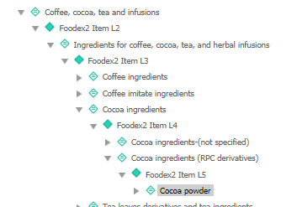
Example 2

Slide 26
RACE tool 27 April 2020
Q&A

Slide 27
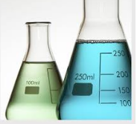

CLOSURE AND TAKE HOME MESSAGES
Analytical results
Use of the tool
OUTCOME

Slide 28
Considerations in characterising the risk
“Outcome” of the decision tree
“considerations”
“interpretation”
No risk
No risk;
Low probability of adverse health effects
Population categories exposed;
Some countries,
Rate of exceedance;
Type of toxic effect;
Severity of the adverse effects;
Duration of exposure;
Characteristics of the food;
Background exposure; ….
Risk
Risk “uncertain”
Risk / Potential risk

Slide 29
EFSA Assessment tools and resources
Feed Additive Consumer Exposure (FACE)
Feed Additives Maximum Safe Concentration in Feed for Target Species calculator (FACTS)
Food Enzyme Intake Model (FEIM)
Food Additives Intake Model 2.0 (FAIM)
Pesticide residues intake model (PRIMo)
Rapid Assessment of Contaminant Exposure (RACE)
https://www.efsa.europa.eu/en/science/tools-and-resources
Assessment calculation tools
Repositories and platforms

Slide 30
Thank you for
attending our webinar!
  In case we did not manage to answer all your questions, please feel free to re-submit them via e-mail sc.secretariat@efsa.europa.eu
  Please take 5 more minutes to fill out the evaluation form that you will receive shortly in your inbox.
  Your feedback will help us improve our service!

